Slide 1
Data source
Credit Scoring
Model Validation
Give Me Some Credit
150,000 observations
10 borrower features
Use case: Consumer lending
Models benchmarked:
Logistic Regression
Decision Tree
XGBoost
Validation conclusion:
Approve with limitations
Logistic Regression model ranks risk well,
but predicted PDs are overstated,
and decision threshold creates fairness trade-offs.
Validator: Bernard Malhame
Date: March 2026
Notes:
[Sources] User-uploaded sources used to build charts: Model Risk Validation BM.ipynb; cs-training.csv. Uploaded source deck referenced for narrative framing: Model Risk Presentation BM.pptx.

Slide 2
Executive summary
The model is stable out of sample and performs well in ranking risk, as shown by AUC of 0.80, KS of 0.45, and low PSI. However, Calibration is weak and fairness outcomes are highly sensitive to the threshold.
Test AUC
Test KS
PSI
Calibration gap
0.80
0.45
0.000
41% vs 7%
Strong rank ordering
Good separation
No meaningful drift
Predicted PD vs observed default
Validation Insights
Key findings
•
Calibration remains weak: mean predicted PD is 41% (class weight = “balanced”) versus 7% observed.
- Logistic regression is stable out of sample: AUC 0.80 and KS 0.45.
•
Recalibrate PDs before CECL, pricing, or stress testing use cases.
- Threshold policy is pivotal for approval rate, and disparate impact (Age groups).
Recommendations
- Ongoing monitoring should include threshold-based triggers (e.g., PSI > 0.1, calibration drift, approval rate shifts) with defined escalation and review processes.
Notes:
[Sources] Charts and values derived from Model Risk Validation BM.ipynb and cs-training.csv.

Slide 3
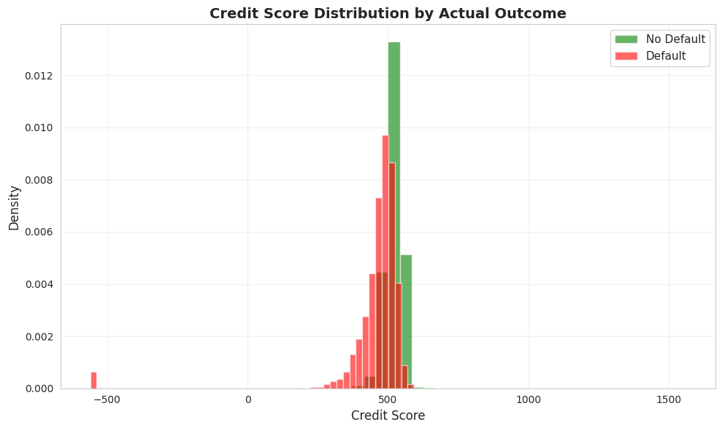
Credit Scoring Use Case is fulfilled: Distribution produces meaningful scores
(Calibration has no effect on distribution)
Clear separation between classes. But fairness trade-offs at the decision level must be monitored.
Notes:
[Sources] Calibration chart built from the uploaded notebook/data.

Slide 4
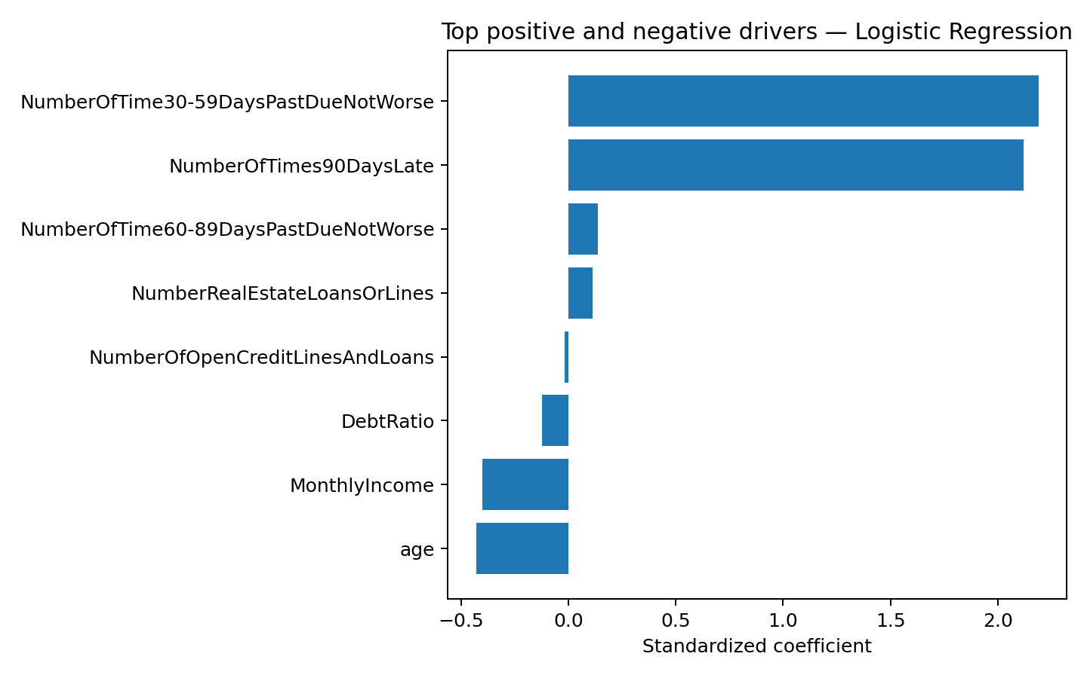
Key drivers
Delinquency variables dominate model behavior.
Data typical of retail credit portfolios:
imbalanced default events
skewed financial variables
delinquency-driven risk signal
therefore, supporting the use of a Logistic Regression credit risk model.
Stratification, scaling, and pipeline use
enable proper performance analysis.
Notes:
[Sources] Coefficient chart built from the uploaded notebook/data.

Slide 5
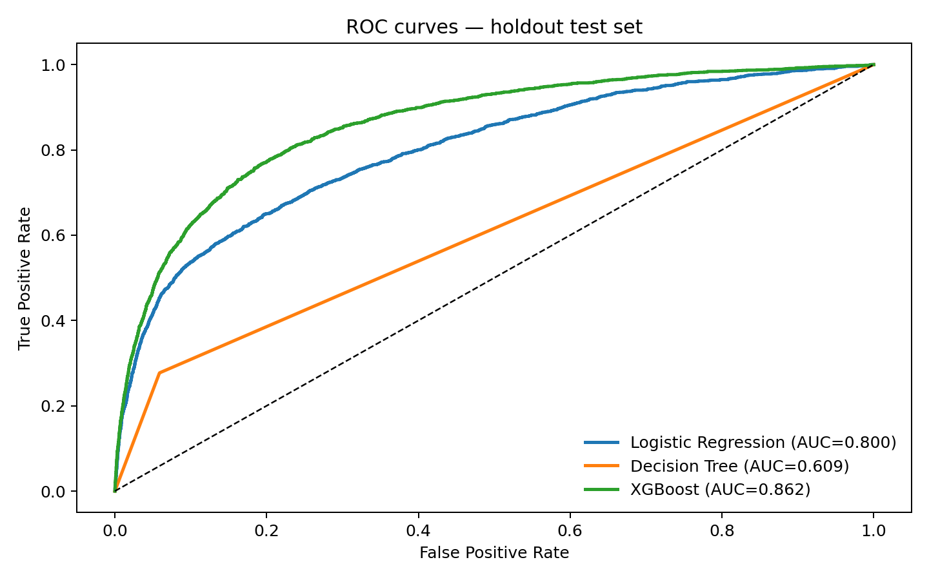
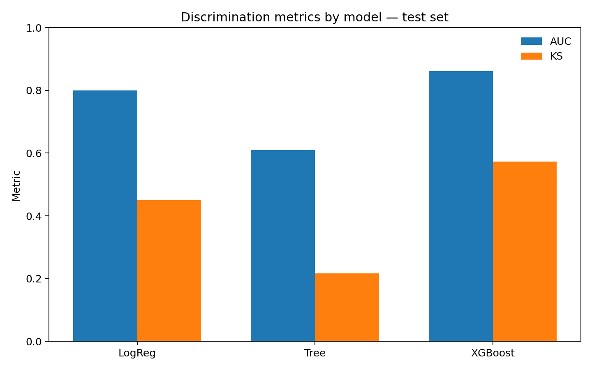
Model comparison: performance vs. governance trade-off
XGBoost leads on discrimination, but logistic regression is the most transparent model for governance and interpretability.
Interpretation
- Logistic regression remains preferred production candidate when interpretability matters.
Test metrics: LogReg AUC 0.80, KS 0.45 | Tree AUC 0.61 | XGBoost AUC 0.86, KS 0.57
- XGBoost materially improves discrimination but raises complexity and governance burden (validation, documentation, monitoring).
- Decision tree memorizes the training sample and collapses on holdout data.
Notes:
[Sources] ROC curves and model metrics built from the uploaded notebook/data.

Slide 6
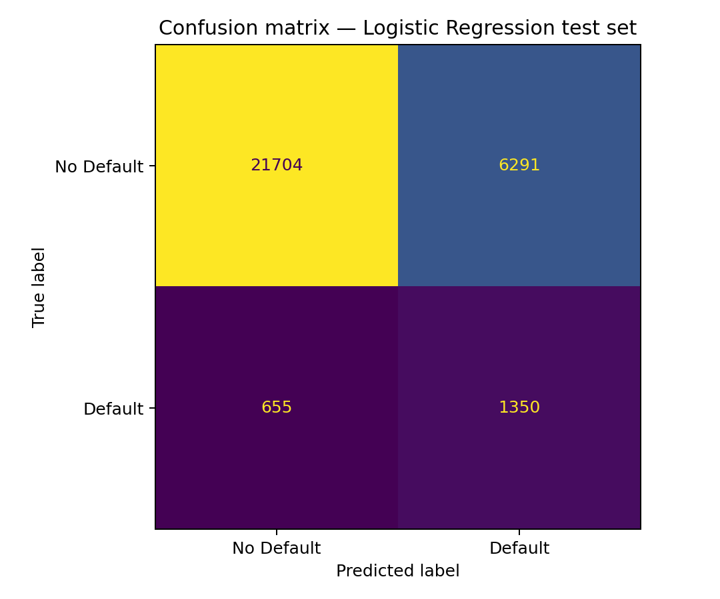
Validation detail: ranking vs. classification trade-off
The model catches many defaulters at the default threshold but also produces many false alarms.
KS =0.45
What this means
At the default 0.5 cutoff, the model delivers recall of 67% but precision of only 18%. That is acceptable for ranking, but expensive for credit decisions without calibration and threshold governance.
KS peaks at 0.45 (Log. Reg.), confirming good separation between defaulters and non-defaulters even though classification precision is weak.
Notes:
[Sources] KS curve and confusion matrix built from the uploaded notebook/data.

Slide 7
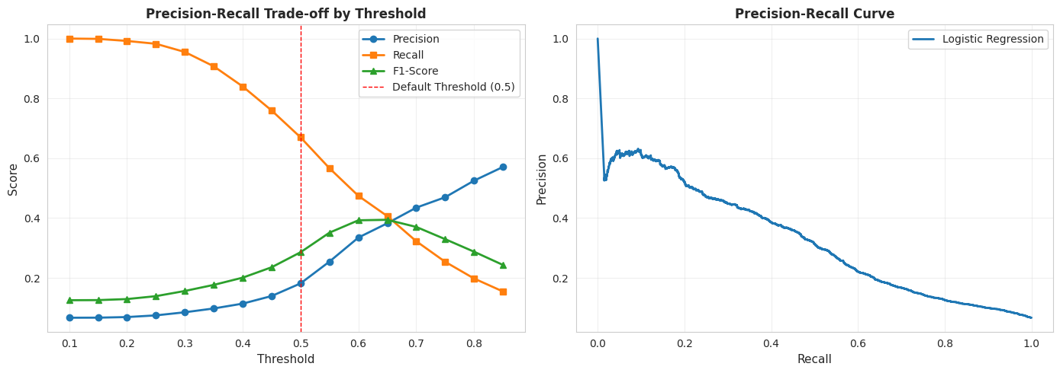
Precision-Recall Trade-off by Threshold
There is no threshold that simultaneously delivers high precision and high recall, so decision policy must be explicitly governed (i.e., business objectives and risk tolerance).
F1-optimal ≠
business-optimal
The model provides reasonable ranking ability, but the precision–recall trade-off highlights that decision outcomes are highly sensitive to threshold selection, reinforcing the need for calibrated PDs and governed decision rules.
Notes:
[Sources] Calibration chart built from the uploaded notebook/data.

Slide 8
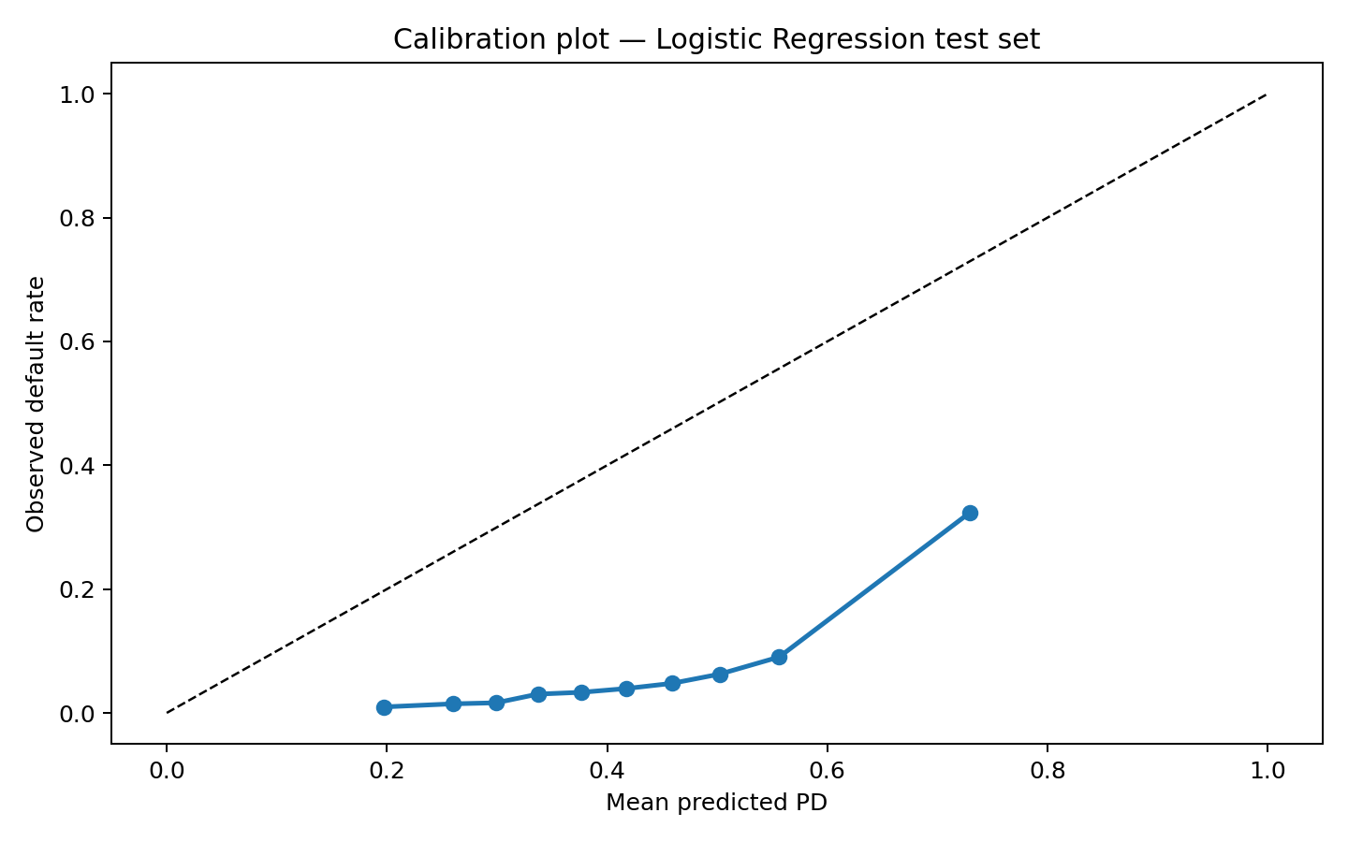
Material calibration deficiency: PDs are overstated
The model orders borrowers well, but the PD scale is not reliable enough for financial use without recalibration.
Mean predicted PD
Observed default
41%
7%
Holdout test set
Holdout test set
Why it matters
- Probability forecasts are materially overstated across most calibration bins (class weight = “balanced”) .
All points below diagonal:
systematic overestimation
- Using these PDs directly would bias pricing, expected loss, CECL, and stress estimates upward.
Key finding: apply a post-model calibration step and validate it separately.
•
Notes:
[Sources] Calibration chart built from the uploaded notebook/data.

Slide 9
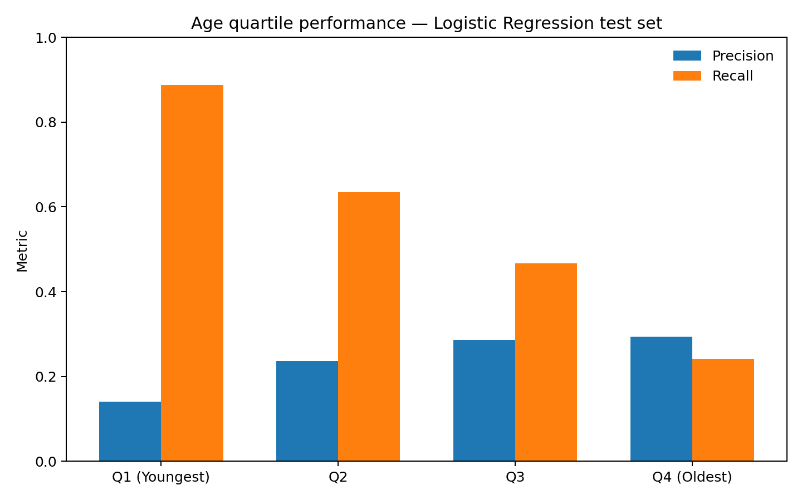
Robustness and fairness across age segments
AUC remains consistent across age quartiles, but precision and recall move meaningfully across groups.
AUC by quartile
Q1 0.776 | Q2 0.770 | Q3 0.784 | Q4 0.772
Interpretation
- Youngest borrowers have the highest recall and the lowest precision.
- Older quartiles show the opposite profile: lower recall, better precision.
- These segment-level differences may create fairness and disparate impact risk if not governed through threshold selection and monitoring.
Notes:
[Sources] Age quartile chart built from the uploaded notebook/data.

Slide 10
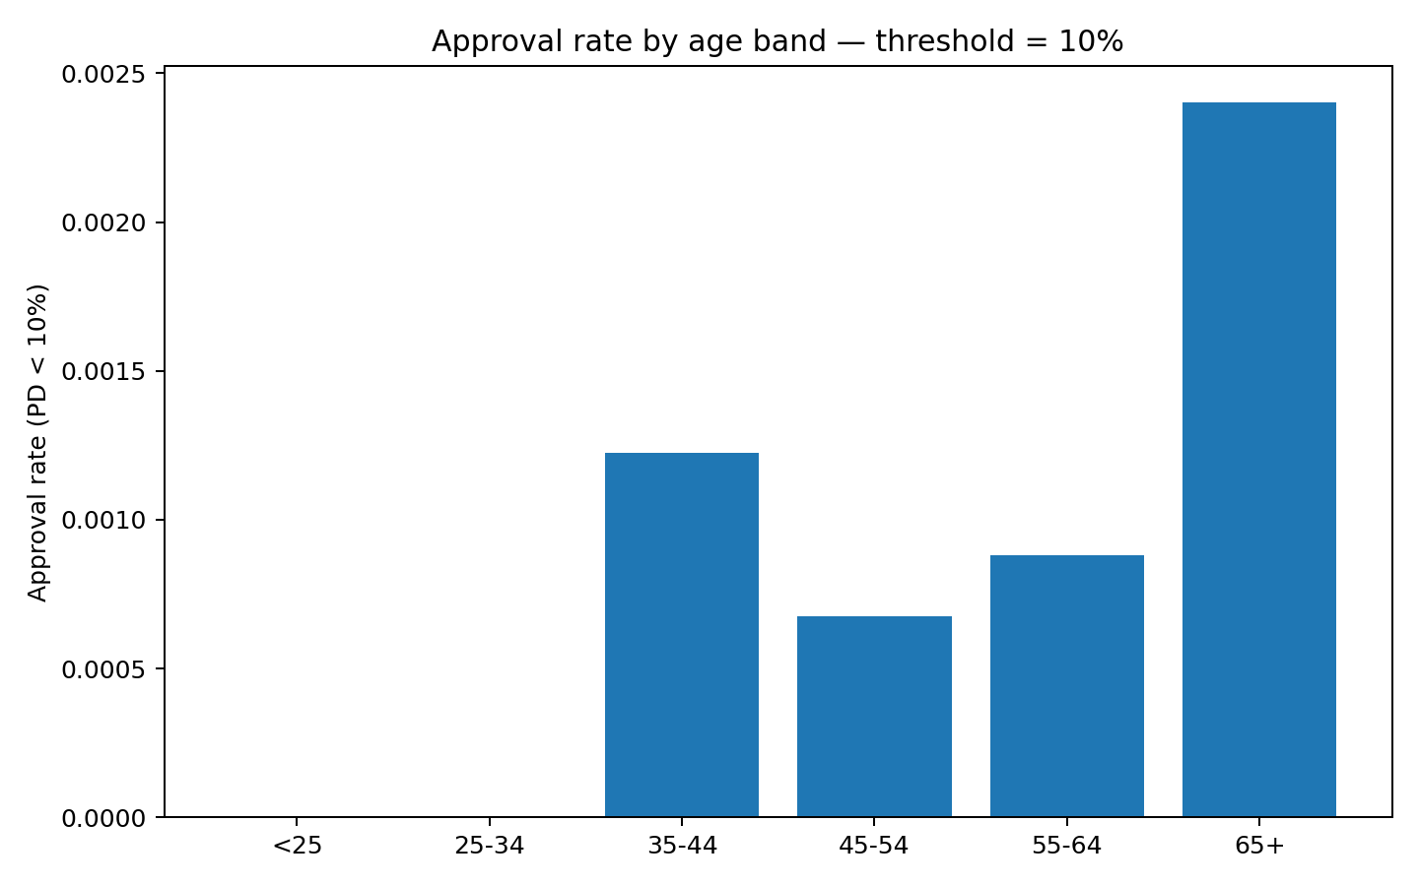
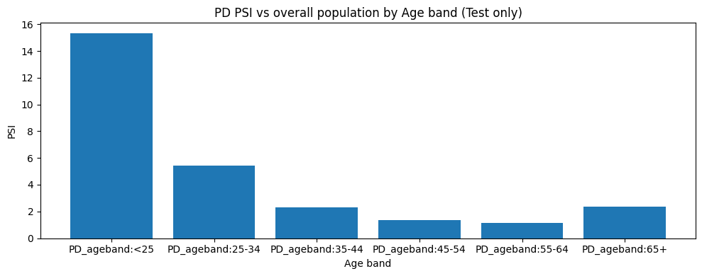
Threshold choice drives outcomes more than data drift does (PSI is close to zero)
The population is stable, but 10% approval threshold and weak calibration mean approvals nearly vanish in several age bands.
PD Distribution Difference by Age Band (vs Overall Population)
- Approval rates are extremely low
- Threshold too conservative given PD calibration
Largest PD distribution difference occurs across age bands, particularly for the youngest (<25) and oldest (65+) groups, where values are significant. Otherwise, PSI is close to zero.
- Recommendation: Enhanced Age Band monitoring (PDs, approval rates).
Notes:
[Sources] Approval-rate and PSI charts built from the uploaded notebook/data.

Slide 11
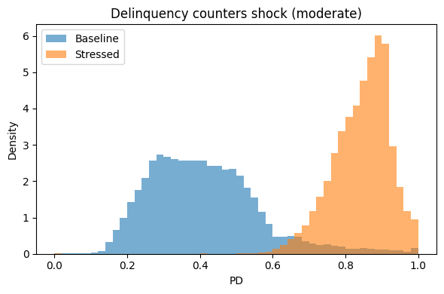
Stress testing: PDs rise under delinquency shocks, while ranking stays stable
Progressively harsher delinquency scenarios shift the PD distribution upward. Ranking is preserved.
Average PD uplift by scenario
Mild | 0.246 Moderate | 0.433 Severe | 0.529
Interpretation
- The shift is monotonic from mild to severe, so the model reacts proportionally to scenario severity.
- Ranking is preserved (Spearman = 1.00).
- Calibration remains the main limitation: stressed PD levels should not be used directly for pricing, CECL, or capital without recalibration.
Recommendation: monitoring should track distribution shifts in delinquency features over time.

Slide 12
Key findings and recommendations
Model risk arises not from model instability, but from calibration (class weight = “balanced”), threshold policy, and segment-level outcome differences.
Key findings
Recommendations
•
Calibrate PDs and document the recalibration methodology.
- Trade-off between recall and precision should be aligned with business objectives and risk tolerance.
•
Set threshold policy with explicit limits for approval rate, and disparate impact.
- Ongoing monitoring should include threshold-based triggers (e.g., PSI > 0.1, calibration drift, approval rate shifts) with defined escalation and review processes.
Notes:
[Sources] Coefficient chart built from the uploaded notebook/data.

